Slide 1

Just For Rookies
A Project by Group 26

Slide 2
Group Members
Harsh Dwivedi (20BCE10023)
Aman Gupta (20BCE10034)
Vinay (20BCE11053)
Suraj Sikchi (20BCE10690)
Ankit Deb (20BCE10495)

Slide 3
Table of contents
01
02
03
04
05
06
Abstract
Introduction
Flow Chart
A brief summary of our project.
The Objective Statement and idea behind our project.
The flow of the website.
Modules
Output
Conclusions
The different pieces of code written for our project.
The output of the project, screenshots of the various pages.
Our concluding statements about the project.

Slide 4
Abstract
JustForRookies
is a website and software that contain solutions for various topics relevant to first year engineering subjects. It is a resource that condenses multiple different subjects into one to provide a streamlined, accessible and user-friendly platform and experience to the user and focuses on quick and easy access to solutions.

Slide 5
Objective Statement
The purpose of this project was to attempt to create a platform that creates ease of access for effective learning with different topics condensed into one resource for students.
Thus arrived the idea behind the website, a place which can provide calculations and solutions for various questions relevant to engineering freshmen.
With the use of HTML, CSS, Django and Python, there has been progress made towards this goal.
We then wanted to also create a small lightweight software that could serve the same function. For this software, we've used the Tkinter module in Python.

Slide 6
Flow Chart
Browser/Software Interface
Visible on the client device
Backend Server
Process the input being received
Cache Server
Accesses the data saved locally
Database Management
Accesses and controls the stored data and info.

Slide 7
Module Split-Up & Explanation

Slide 8
Classifications
Front-end
Back-end
Software
Uses CSS, HTML. The visual layout of the website.
Uses Django and Python. The processing happens here.
Uses Python with the Tkinter library. The software is entirely created through this.
First, the Front-End:

Slide 9
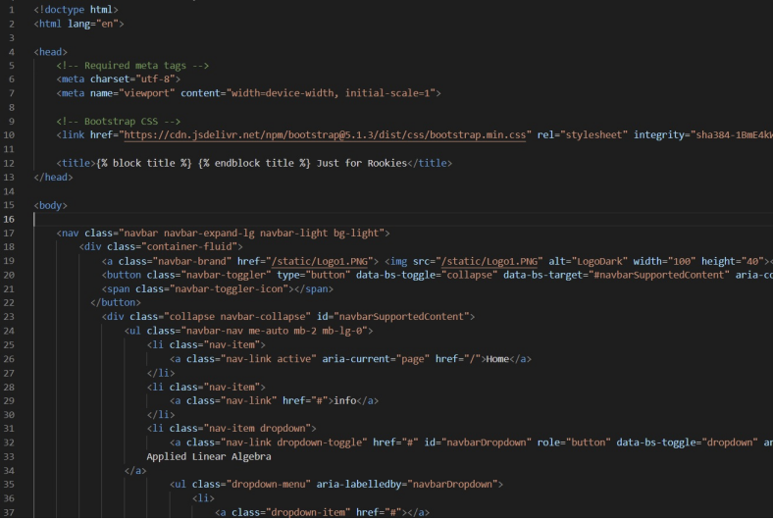
Base File
This module contains the initial framework that is then extended in different webpages.

Slide 10
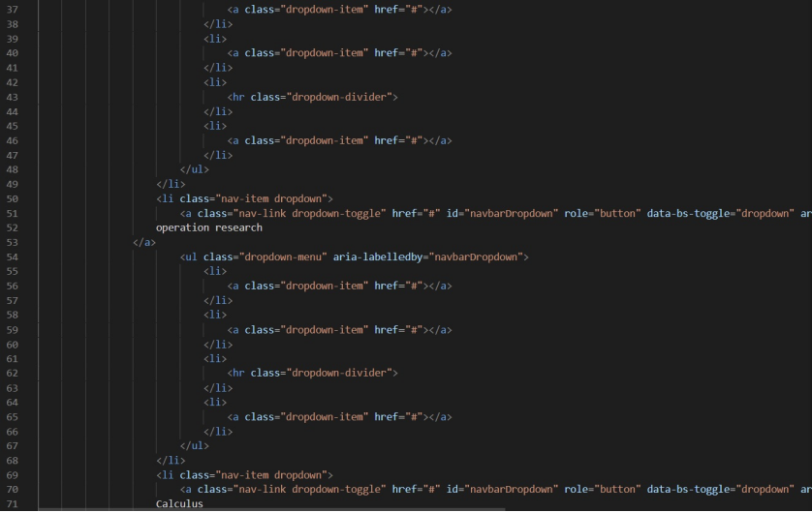
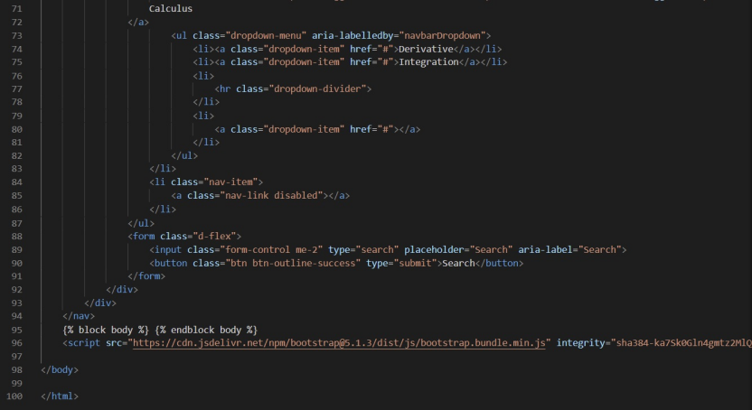

Slide 11
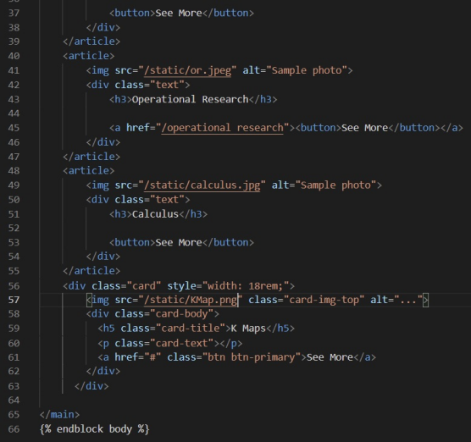
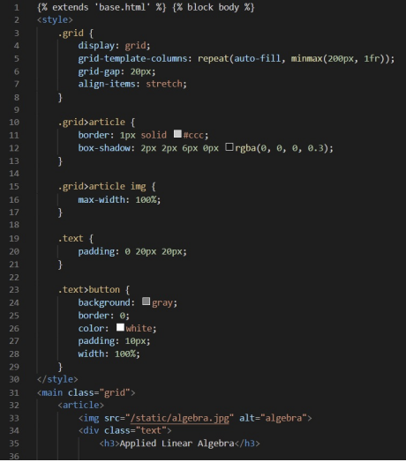
Index Page
This module contains the code for the homepage

Slide 12
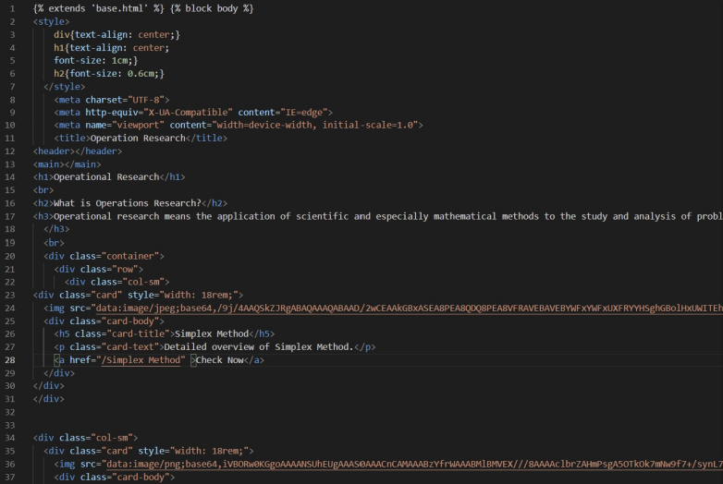
Subject Page
This module contains the code for the webpage containing all the sub-topics in the subject Operations Research.

Slide 13
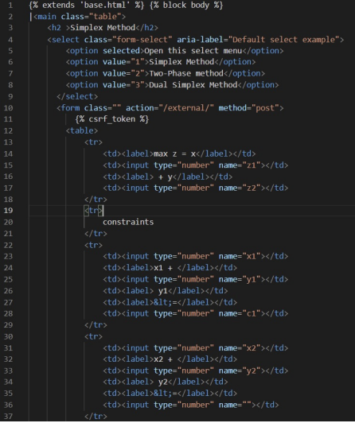
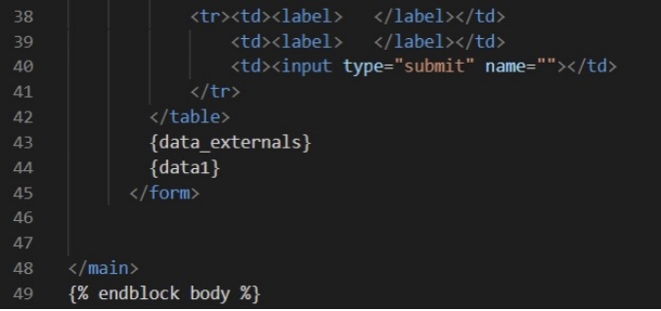
Simplex Method Page
This module contains the code for the web page for the Simplex Method.

Slide 14
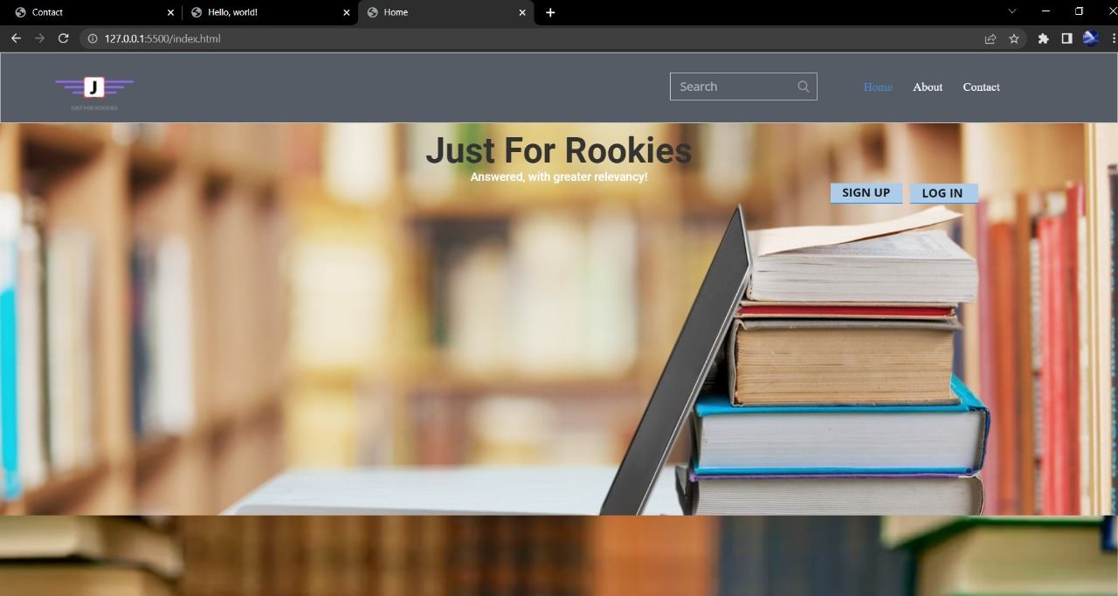
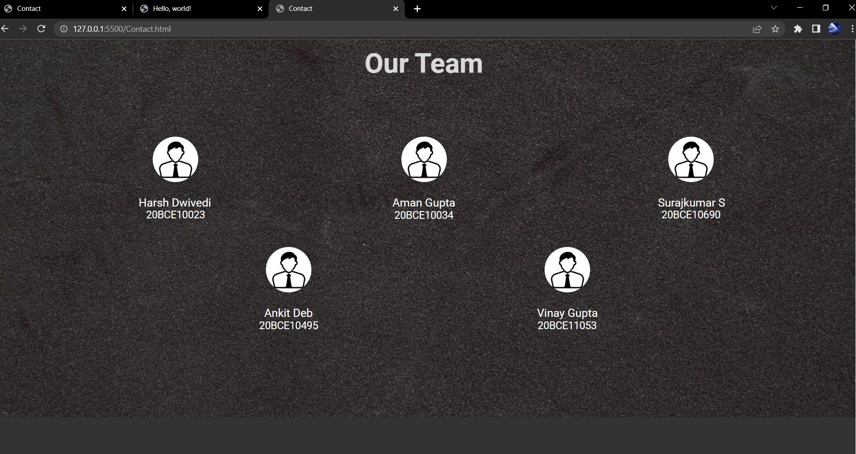
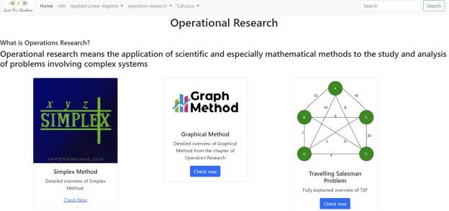
The Website

Slide 15
Python Back-End
Here we have two sections
First, the code for the Simplex Method.
Second, the code for the Gauss Elimination method.

Slide 16
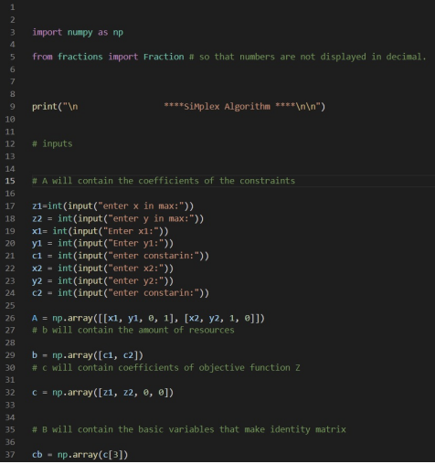
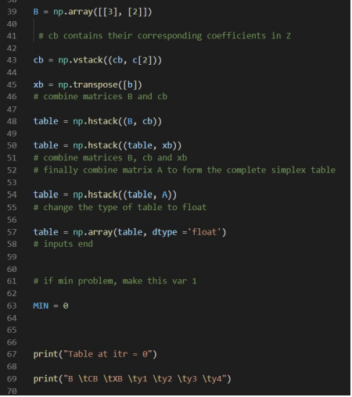
Simplex Method
This is the back-end code for the Simplex method, coded in Python.

Slide 17
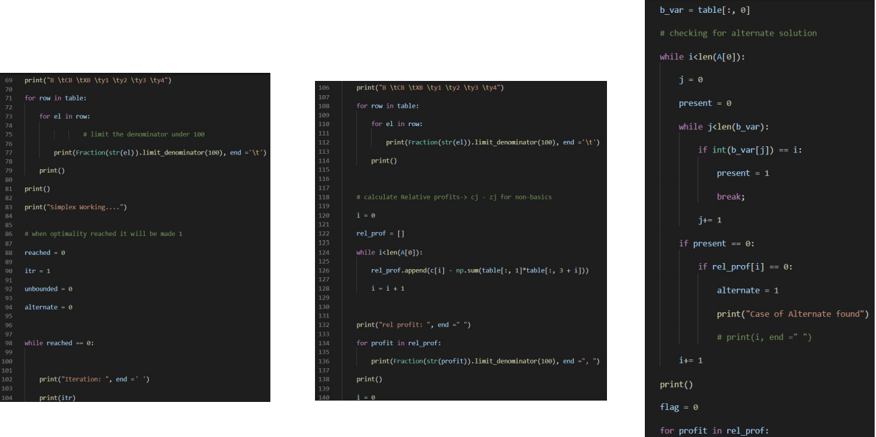

Slide 18
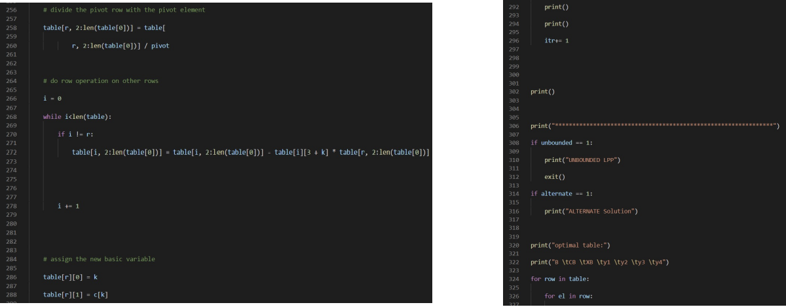

Slide 19
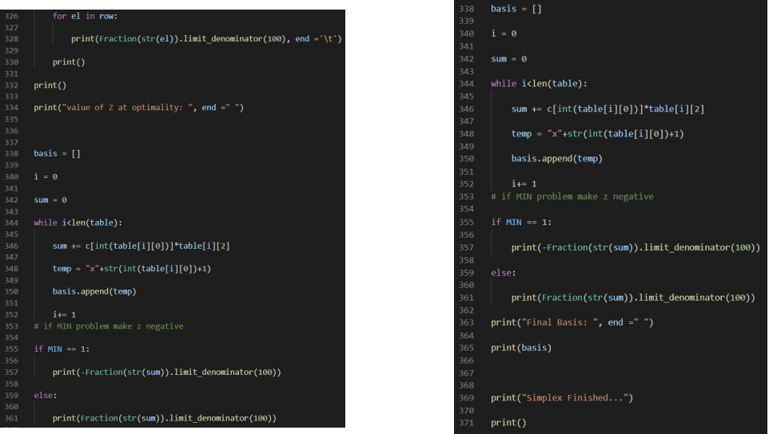

Slide 20
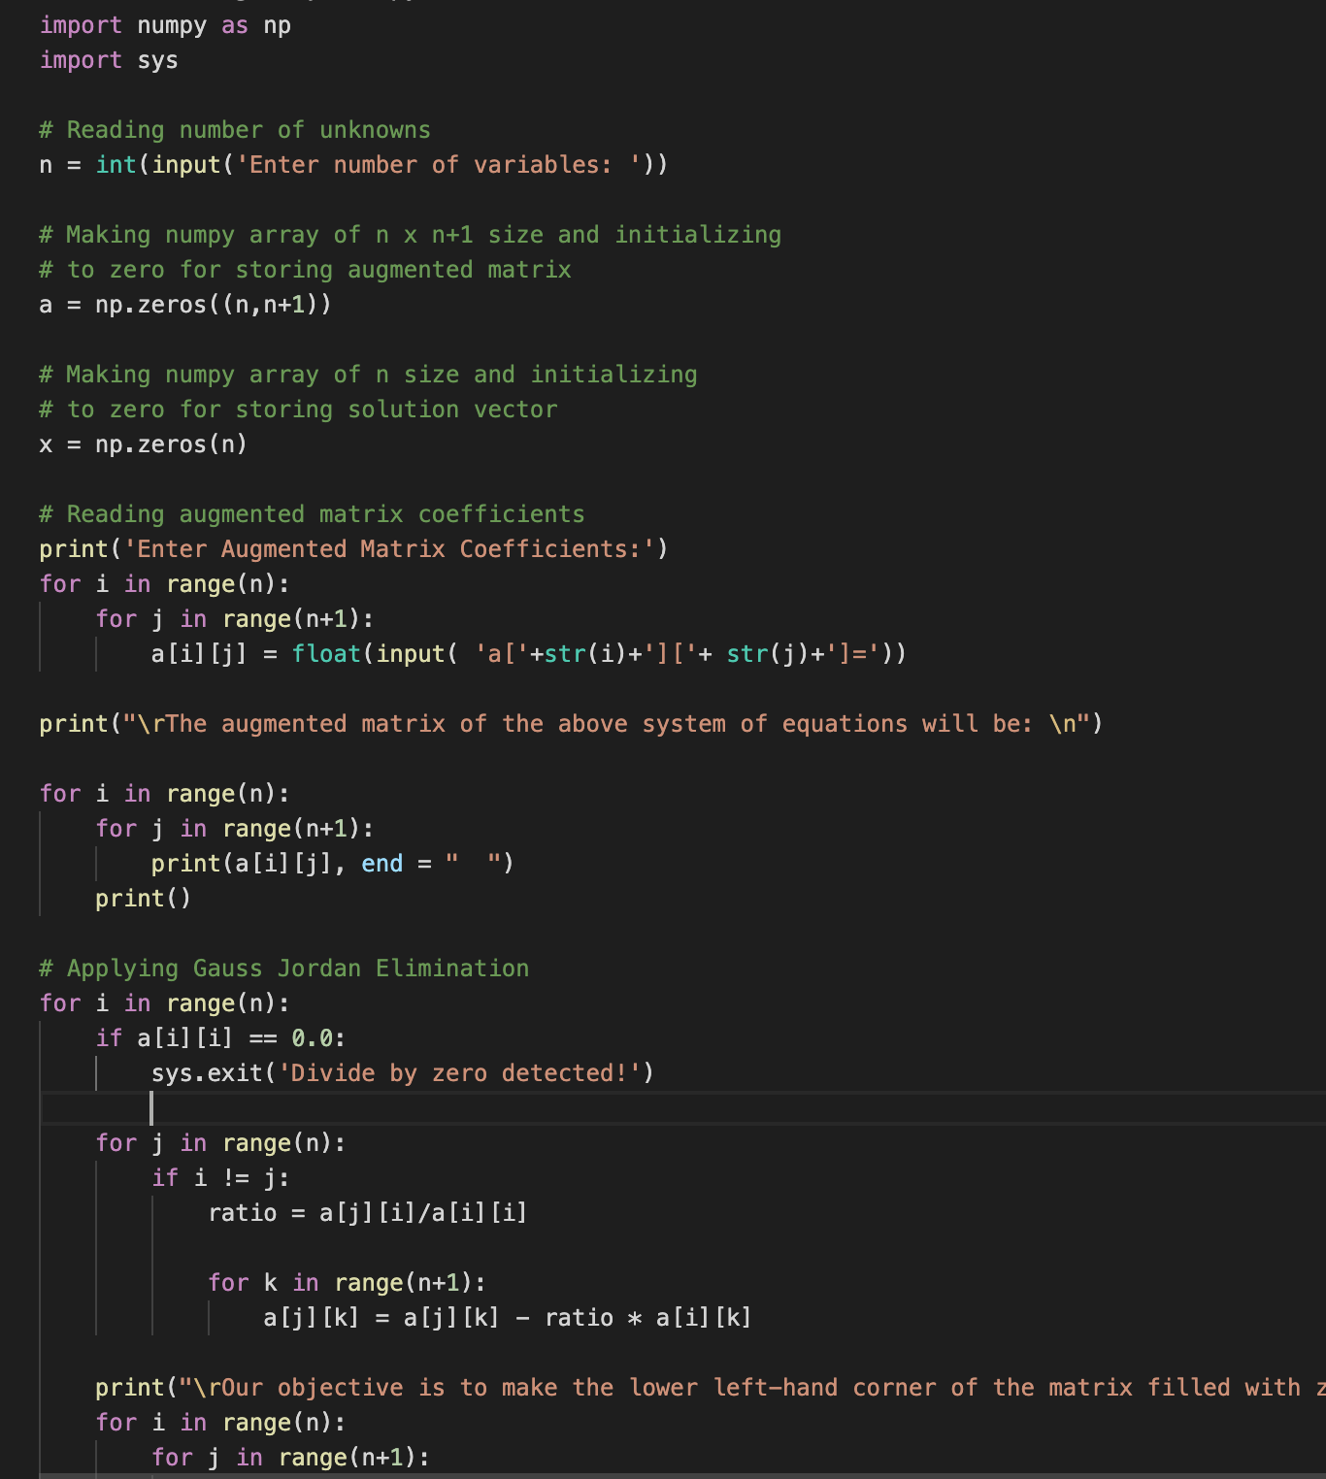
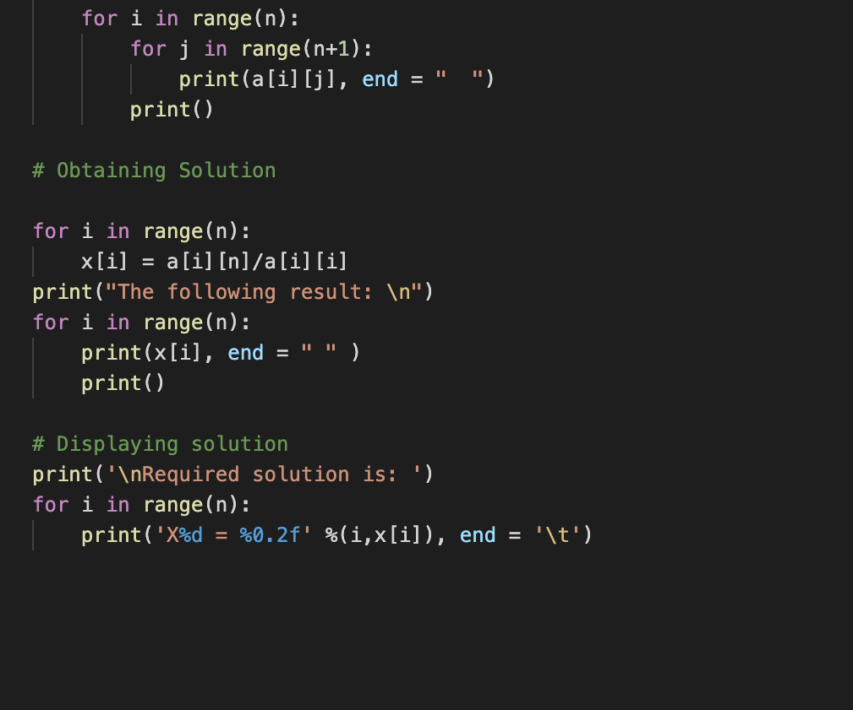
Gauss Elimination Method
This is the back-end code for the Gauss Elimination method, coded in Python.

Slide 21
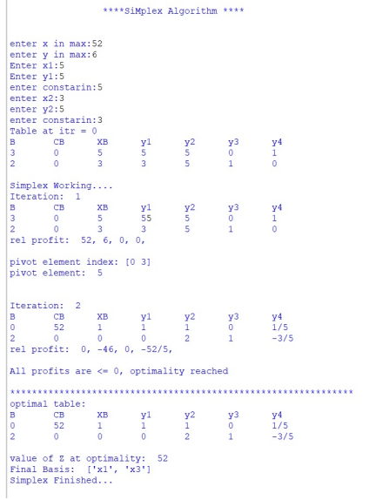
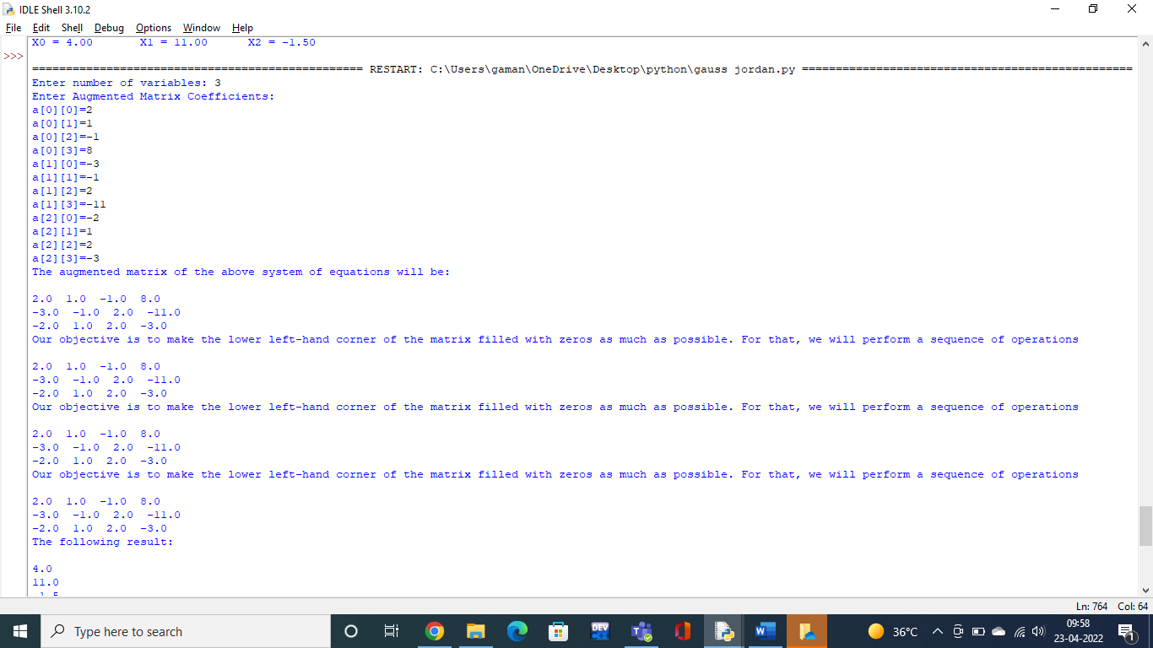
The Outputs

Slide 22
Tkinter Software
We wanted to also try creating a software that served the same purpose as the website and worked in a similar manner.
For this, we used the Python library Tkinter.
It runs the Simplex method, similar to the website. It has a rather basic, barebones UI at present, but takes the required inputs and presents the output in a clear and understandable manner.
Tkinter is Python's de-facto standard GUI (Graphical User Interface) package. It is a thin object-oriented layer on top of Tcl/Tk.

Slide 23
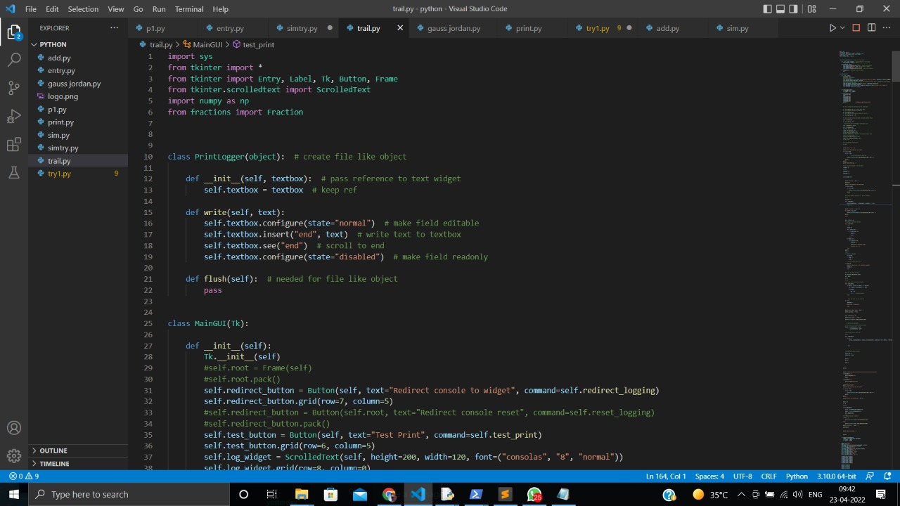
The Code

Slide 24
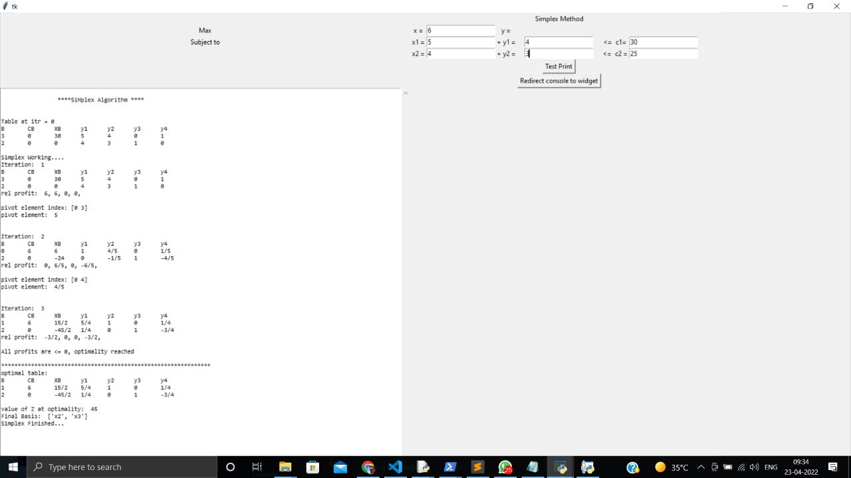
The Output

Slide 25
Timeline
January
February
March
April
Group formed; brainstorming for ideas.
Initial work begins. Website layout created.
Review 1.
Further work done, python code implemented.
Review 2.
Finishing up the project; creating the software. Review 3.

Slide 26
Conclusion
The work put into this project served as quite an enriching experience. It provided us an outlet through which we were offered insight into the process of web development and the various elements involved in it. It also offered us great insight into basic software development procedures.
There clearly exist a plethora of similar resources out there but we believe the utility of our project lies in the ease of access and use rather than ground-breaking innovation. Thus, despite the market it serves being rather saturated, we believe the idea has potential to be highly useful.

Slide 27
References
GeeksForGeeks.org
StackOverflow.com
GetBootstrap.com
YouTube.com

Slide 28
Thank You!

